Slide 1
2008 Cosponsorship Network of 91 Senators
Cindy Cheng, Daoyang E, Yuwei Wu

Slide 2
Why Cosponsor?
Agenda setting
Signaling
Personal reputation
Coalition building

Slide 3
What Factors Affect Cosponsorship?
Seniority
Senior senators and members who take leadership positions have larger impact on the decision making process than junior members.
Reciprocity
Legislators who cosponsor their colleagues' bill can expect similar support in return.
Party affiliation
Minority party members are more likely to cosponsor legislation than majority party members.
Education
Homophily effects
state
gender and race/ethnicity?
Transitivity

Slide 4
Research Question
H1: Seniority is positively correlated with the number of bills cosponsored by a senator.
H2: There is a homophily effect among senators who share certain characteristics in party affiliation, gender, educational background, and state.
H3: Members of the minority party (Republican and Independent in 2008) will co-sponsor more bills than members of the majority party (Democratic in 2008).

Slide 5
Dataset
Attributes
Party
State
First Year
Seniority
Age
Race
Gender
Education

Slide 6
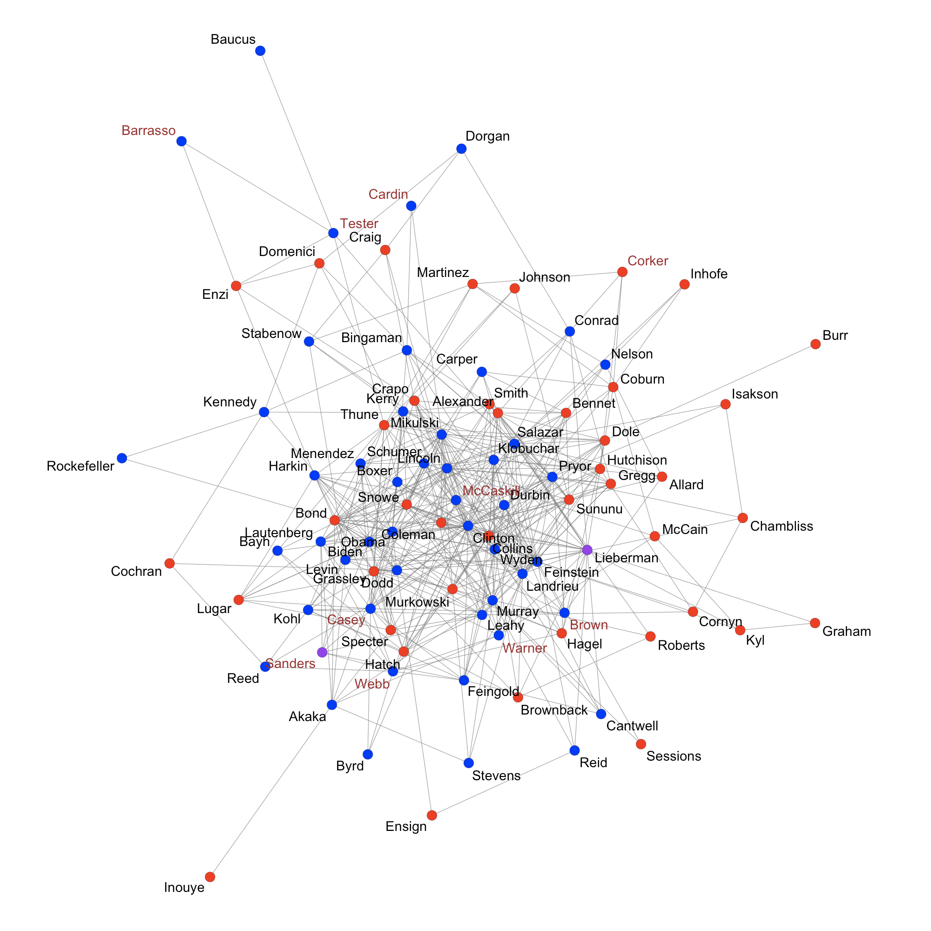
Network Plot
Undirected network
Color of nodes:
Democrat = blue
Republican = red
Independent = purple
Color of labels:
First-year senator = brown
Others = black

Slide 7
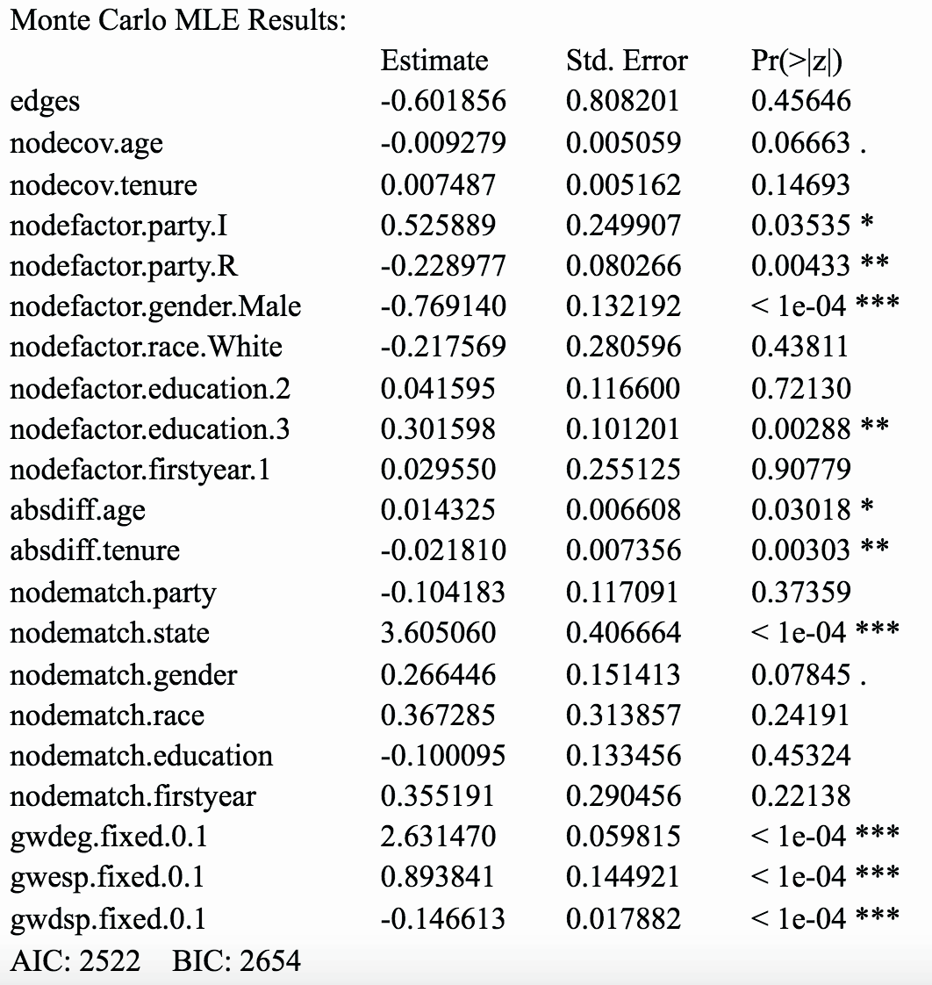
ERGM Results
Covariate effects
Party affiliation
Gender
Education
Homophily effects
Age
Tenure
Geography
Local structures
Degree
Transitivity

Slide 8
Thank you!

